Slide 1
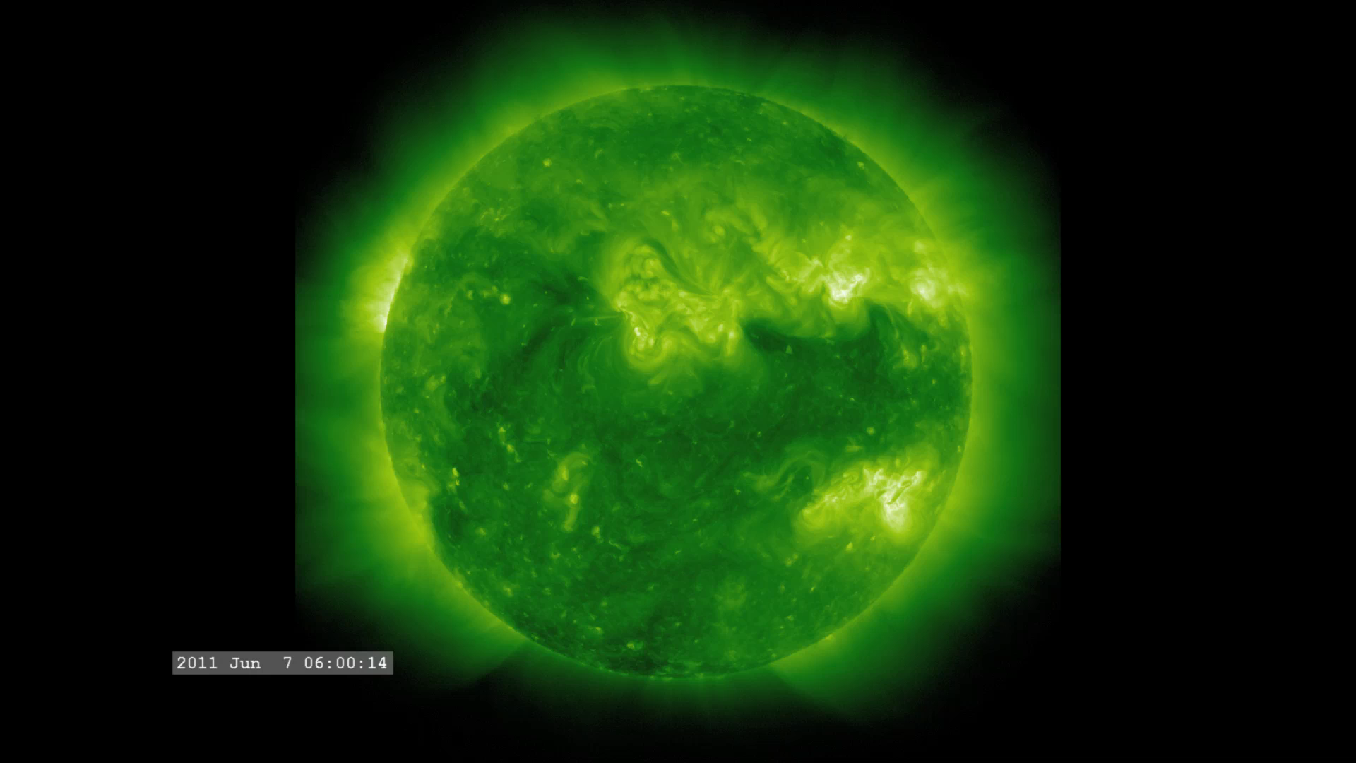
Notes:
Our Incredible Sun (211 Ångstroms)
Who knew a large ball of hydrogen and helium at the center of our solar system could cause such an eruption? On June 7, 2011, a solar flare occurred on the sun, which released a very large coronal mass ejection (CME). Most of the ejected material is much cooler (less than about 80,000K) than the sun and therefore appears dark against the brighter solar disk. Material that does not reach solar-escape velocity can be seen falling back and striking the solar surface, sometimes triggering smaller events.
NASA’s Solar Dynamics Observatory (SDO) observes the sun in many different wavelengths of light. This image series taken by SDO's Atmospheric Imaging Assembly (AIA) instrument at 211 Ångstroms is captured at one-minute intervals. NASA’s SDO satellite helps us understand how the inside of our sun works, and how energy is stored and released in the sun’s atmosphere.
Credit: NASA/Goddard Space Flight Center Scientific Visualization Studio
Source: http://svs.gsfc.nasa.gov/vis/a000000/a003800/a003840/
FRAME C4: MonsterFilament.211A.0038_11.png
Short description:
On June 7, 2011, an M-2 flare at a wavelength of 211 Angstroms occurred on the Sun which released a very large coronal mass ejection (CME). Solar Dynamics Observatory (SDO) captured this image sequence at one minute intervals and is designed to play animations synchronously.

