Slide 1
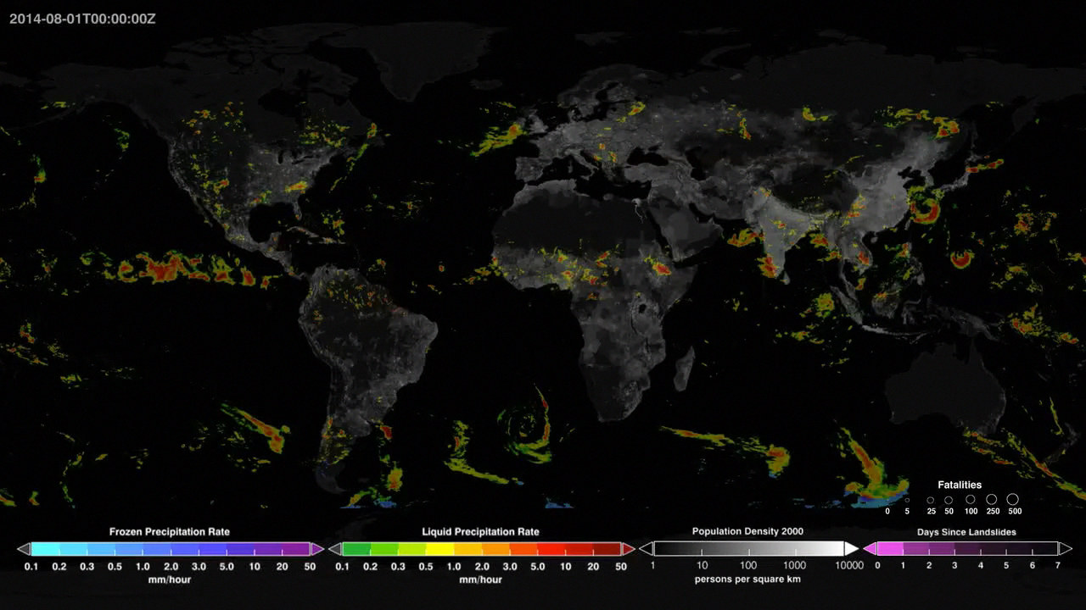
Notes:
Global Rainfall-Triggered Landslides
This visualization shows rainfall-triggered landslides and precipitation from August and September of 2014. Landslides occur when an environmental trigger like an extreme rain event, often a severe storm or hurricane, and gravity's downward pull sets soil and rock in motion. Conditions beneath the surface are often unstable already, so the heavy rains act as the last straw that causes mud, rocks, or debris—or all combined—to move rapidly down mountains and hillsides.
Here the NASA Global Landslide Catalog (GLC) is shown with precipitation data detected by NASA's Integrated Multi-satellite Retrieval for the Global Precipitation Measurement Mission (IMERG). The GLC was developed with the goal of identifying rainfall-triggered landslide events around the world, regardless of size, impact, or location. The GLC considers all types of mass movements triggered by rainfall, which have been reported in the media, disaster databases, scientific reports, or other sources. The GLC has been compiled since 2007 at NASA’s Goddard Space Flight Center. This is a valuable database for characterizing global patterns of landslide occurrence and evaluating relationships with extreme precipitation at regional and global scales.
For more information, visit:
ojo-streamer.herokuapp.com

