Slide 1
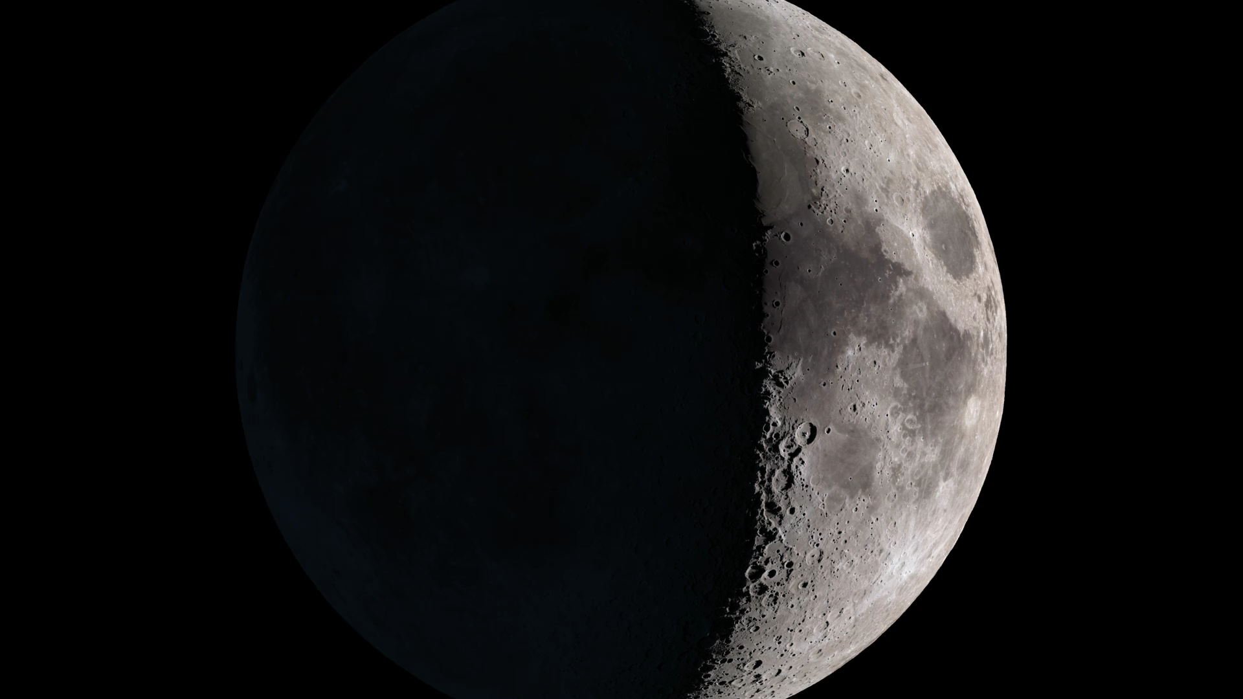
Notes:
Gardening Rates on the Moon
No, not that kind of gardening. In this case, “gardening” refers to the mixing and disturbance of the top layers of lunar regolith that happens when impacts form new craters. The material excavated from the crater site is sprayed in all directions, creating secondary craters and splats of lighter and darker dust on the surface.
The narrow-angle camera LROC NAC(http://www.lroc.asu.edu/) aboard Lunar Reconnaissance Orbiter LRO(https://lunar.gsfc.nasa.gov/) has photographed a large percentage of the Moon's surface multiple times. By looking for differences between earlier and later images, the LROC team has found over 200 new craters large enough for the camera to see (at least 5 meters in diameter), as well as thousands of what they call “splotches,” many of which are likely caused by smaller craters.
In a paper in the October 13, 2016 Nature (http://www.nature.com/nature/journal/v538/n7624/), Emerson Speyerer and his coauthors divide the crater ejecta into four zones that differ in brightness and distance from the crater, and they explain the processes involved in the formation of each zone. They also use the number of craters and splotches to infer the gardening rate, the rate at which the top few centimeters of regolith is churned and replaced by impacts. Their conclusion is that this is happening over <i>100 times faster</i> than previously thought.
The visualization simulates the formation of one of the craters featured in the paper. We first see a flash, then zoom all the way to the surface, where the animation blinks between the actual before and after LROC NAC images (M1105837846R and M1121160416R) that were used to detect this new 12-meter crater. Finally, we see the ratio of the two images, which very clearly shows both the new crater and the radial pattern of ejecta.

