Slide 1
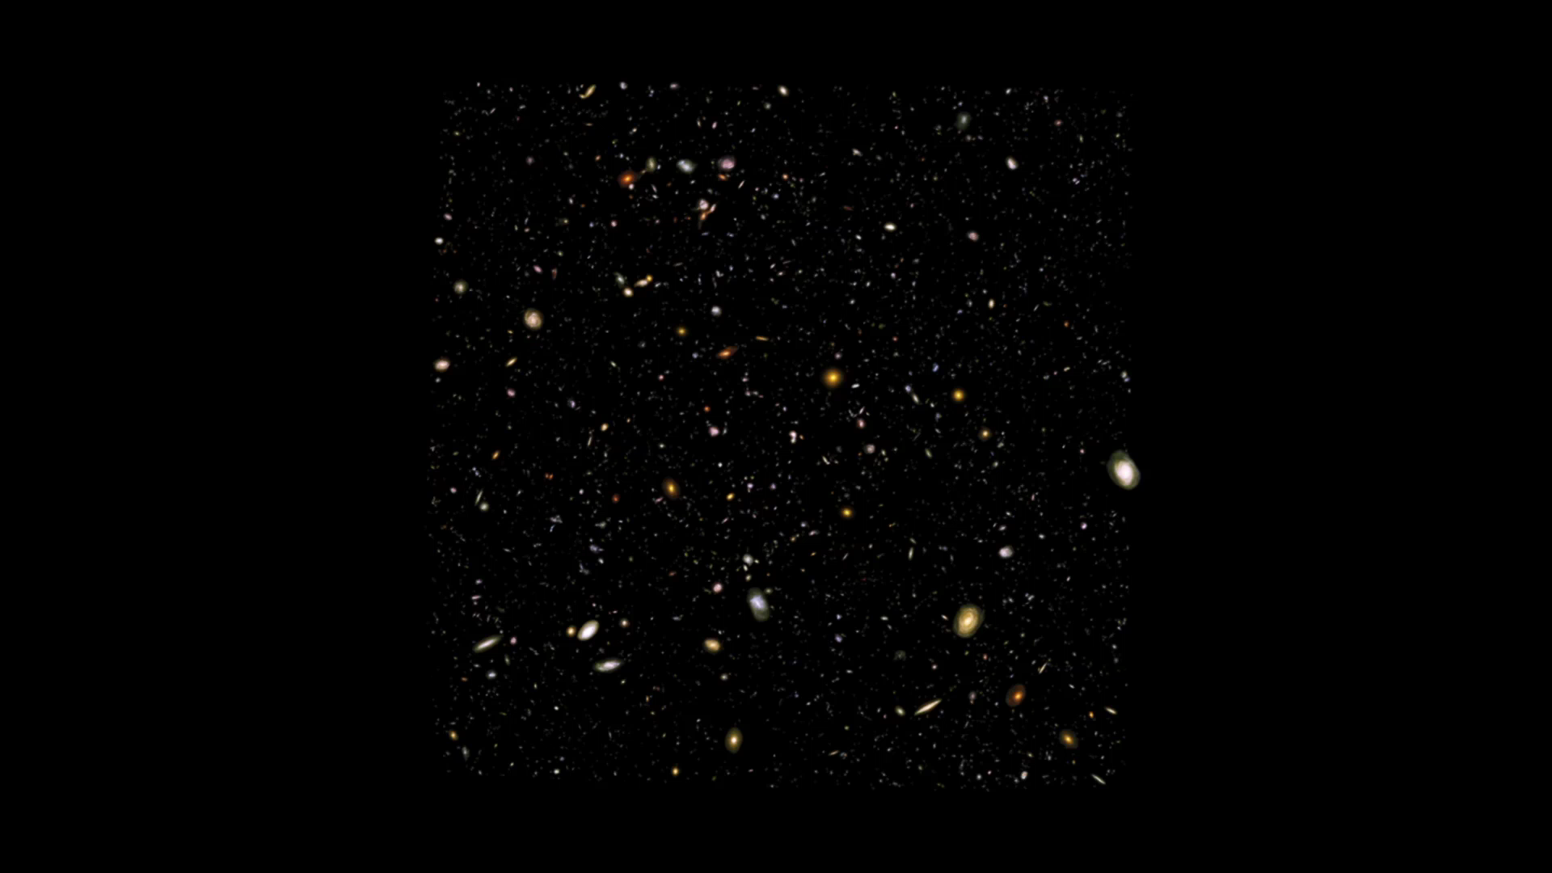
Notes:
Hubble Ultra Deep Field
This scientific visualization flies through a 3D model of the HUDF galaxies. Each of the more than 5,000 galaxies in the model was cut out of the HUDF image and placed at its appropriate distance (as calculated from redshift measurements). The virtual camera flies through this long, thin galaxy dataset, showing how galaxy sizes, shapes, and colors change as one looks both out in space and back in time. Note that, in order to traverse the cosmos in a reasonable amount of time, the distance scale in the model was compressed.

